Slide 1


SAP UI5 & FIORI with OData TRAINING
Anubhav Oberoy & Shekhar Vedi
Day – 13

Slide 2

Agenda – Day 13
Implementing Create in the UI
Implementing Upadte in UI
Implementing Delete uisng UI
Calling Function Import form the UI
Introduction to GitHub
Creating Fiori App using Template in BAS
Creating App in VS code uisng Template

Slide 3
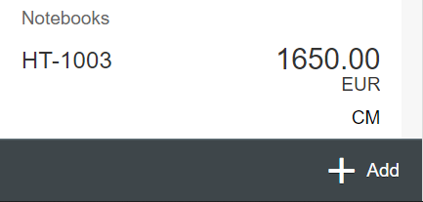
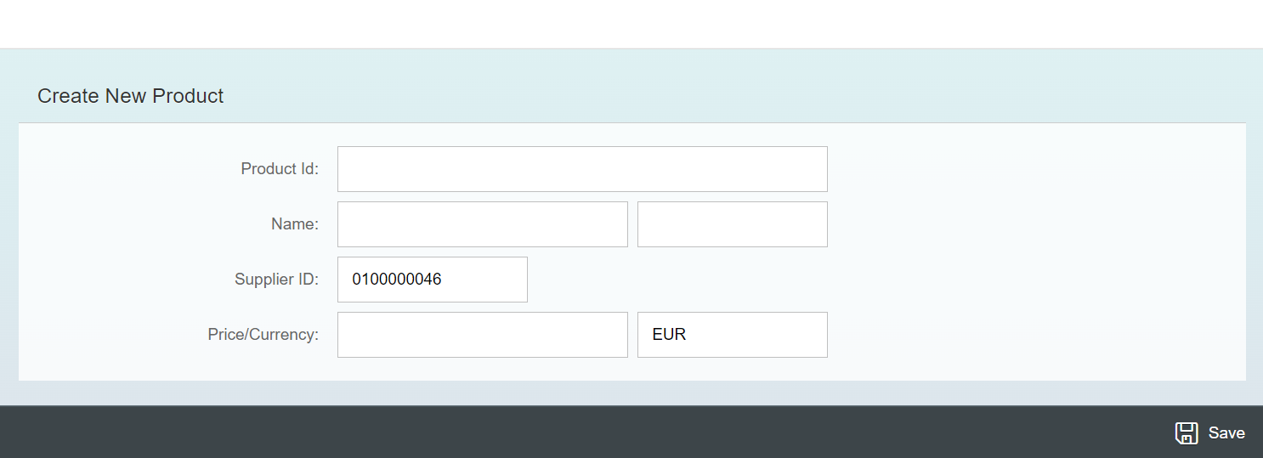
Exercise - Implement Create using UI
Now we will implement create operation in the UI. To do that we need to add a new screen in our application. In that screen we will add a simple form to fill the details of the product and a Save button in the footer of that page.
For this have to a new Add button in the footer of the View1 and on press of that button we will navigate to the new Add View.
Exercise code/resource:
View1.view.xml
View1.controller.js
Add.view.xml
Add.controller.js
manifest.json

Slide 4

Exercise – Implementing Update and Delete
Now we want to Update and Delete the selected record form the backend. To do that we will load the data of the record. Once the data is loaded to update and delete the data, we will add two buttons in the footer of the view named as Save and Delete. We will also add a clear button to clear the data of form.
On entering the Product ID of the product in the Input field and press enter we will load the data of that product in the Form.
Exercise code/resource:
Add.view.xml
Add.controller.js

Slide 5
Exercise – Using Function Import from UI
Now we want to Call the function import form the UI. To do that we will add a button near the Product Id input field. On press of that button, we will load the most expensive product in the form.
Exercise code/resource:
Add.view.xml
Add.controller.js

Slide 6

Introduction to Git and GitHub
Git is a version control system that lets you manage and keep track of your source code history.
GitHub is a cloud-based hosting service that lets you manage Git repositories.
Git HUB is a central repository to store all the code. Git is a distributed repository management system, which allows development teams to organize and sync their development code.
Use Case- I am working as a Fiori Developer in an MNC and I want to share my code with fellow developers, currently I am downloading the zip/tar file and sharing over email.
This way we will have piles of emails in our account,
especially when we work in a team of size 40 developers it becomes very hard to sync changes.
There is version control. Last night my app was stable, I made some changes this morning which messed up the whole project. I some how pray to god that can you please take me in past.
In a big team, many developers touching each other’s code and it’s hard to blame someone who disrupt the code.
It is also very hard to merge changes when done in same file.
As a developer, I am using BAS today, tomorrow I will use VS Code and next day Web IDE and very next week Atom. How can I easily port my code between these tools.
You can install git in local machine using below link (however, it comes along with all dev tools)
https://git-scm.com/downloads

Slide 7


How GitHub Works and commands in Git
We will see some important commands related to Git and will see how GitHub works.
Some important commands to use git.
git Init: It is used to initialize a new Git Repository in the system.
git add <filename>: It is used to stage the changes of the file to git repository. We can use ‘git add .’ to stage the changes of all files.
git commit: It is used to commit all the staged changes with a message.
git reset hard: Discard all the staged changes and discard the changes in all the files.
git push: It is used to push all the changes in the git repository.
git pull: It is used to pull the new changes made by other users in the project.
git status: It is used to check the status
git clone: It is used to clone a repository.
git remote add <repo URL>: Add a local repository to a remote repository.
Fiori Project (or any kind of project)
User (Anubhav)
But how all users will work on the project at a same time?
Anubhav’s local machine
Here GitHub comes into picture
Users which are working on the different parts of the same project on different Platforms (BAS, VS Code, Web IDE)
Project Repository
The project will be kept in a repository in the GitHub

Slide 8
Title
Content

Slide 9
Title
Content

Slide 10
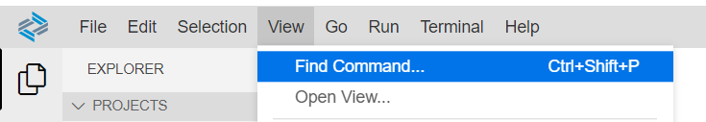
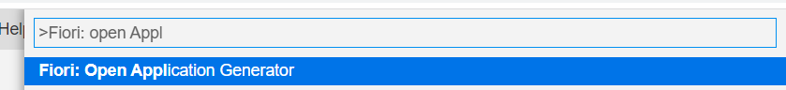
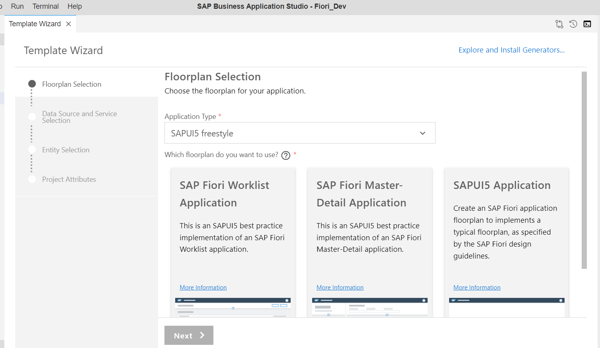
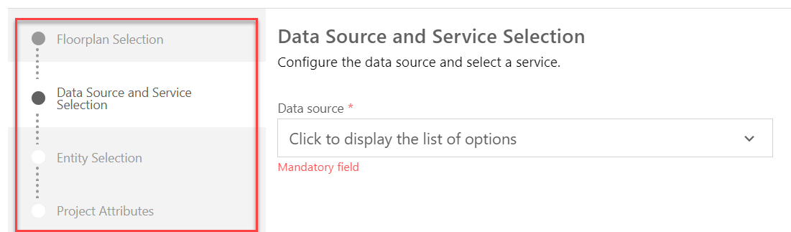
Creating Fiori App with Template in BAS
Steps to create a project using template in BAS.
Step 1: Click on the View tab and open the command pallet.
Step 2: In command pallet search for >Fiori: Open Application Generator and Select it.
Step 3: After Selecting it A new Template wizard will open. In the template wizard select the type of application and floorplan of the application and follow the configuration steps.
Step 4: Configure the Data Source and Service. Add the required Project attributes and Finish then your application will be generated.

Slide 11
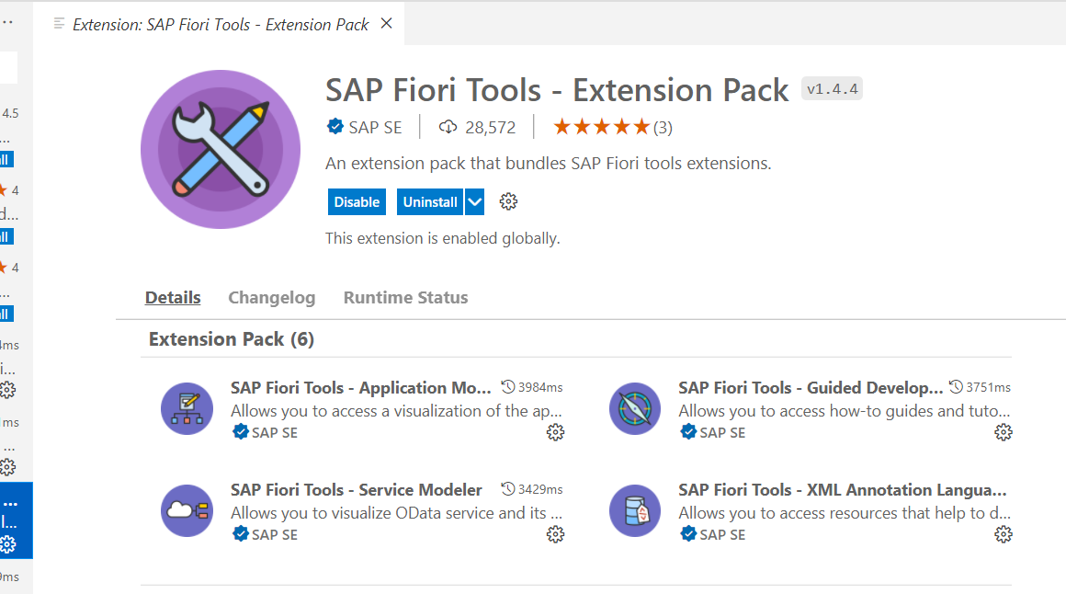
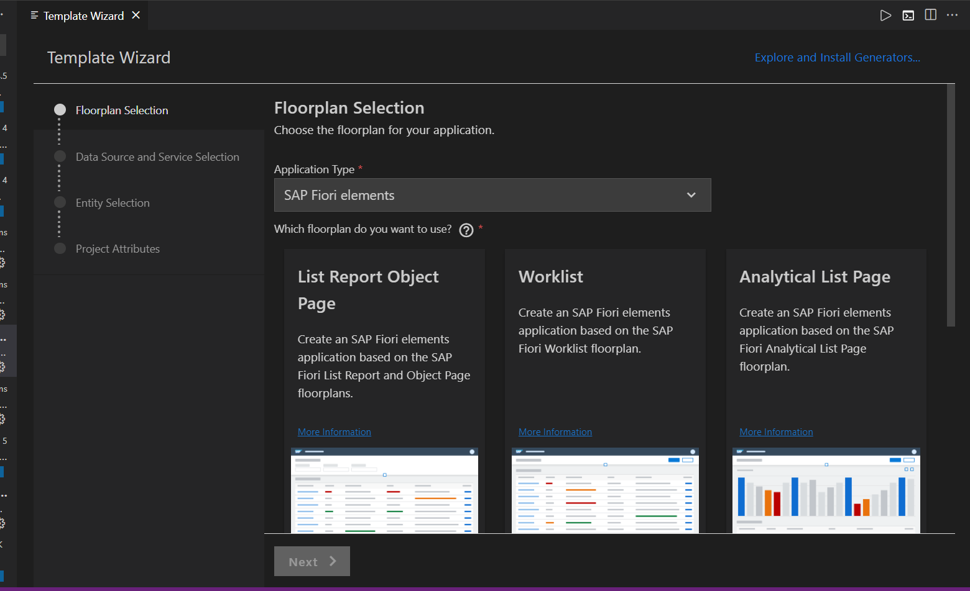
Creating Fiori App using Template in VS code
Before we start generating application in VS code, we need to verify that Fiori Tools are installed in our system or not. To do that we need to install an extension pack in VS code, which is SAP Fiori Tools – Extension Pack.
Once the installation of extension pack is completed, we can follow the same steps which are specified in the previous slide. In which we have generated the application using template in BAS.
When we open the Template Wizard in VS Code then, we will see a similar screen which we have seen in the BAS.

Slide 12

End of Day 13

Slide 13

Questions

Slide 14

Anubhav Oberoy

Slide 15


We’re committed to empower you to be
Most Desirable Resource
through powerful training solutions.
We build the workforce of the future.
250+
Corporate Clients
30,000+
Learners Trained
25000+
Learners Placed
FREE WEBINARS
Sign up for free webinars with industry experts every fortnight!
Enroll Now!
Contact us today!
https://anubhavtrainings.com/

Slide 16




More from AnubhavTrainings.com

Slide 17
Title
Content

